Slide 1


Software Engineering Bootcamp
Java & Angular
powered by Pfizer
Sacchon
A Diabetes Management
Web Application
November 3, 2020
By: Haritini Zisi, Nikos Delis, Thomas Ferfelis, Katerina Skoumpourdi

Slide 2
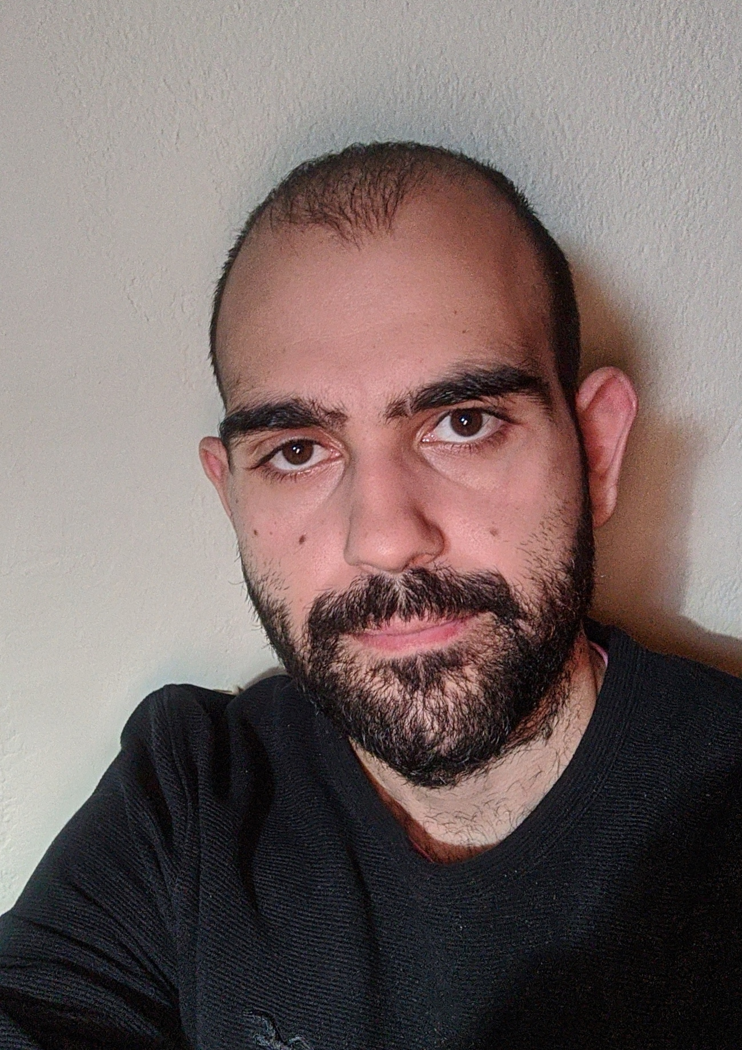

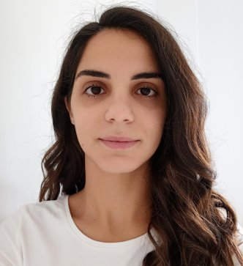
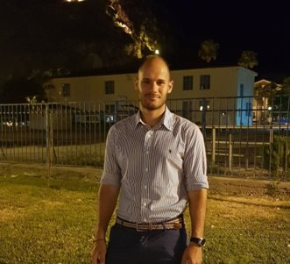
Meet our Team
Haritini Zisi
Software Engineer
Thomas Ferfelis
Computer Engineer
Nikos Delis
Software Engineer
Katerina Skoumpourdi
Electrical & Computer Engineer

Slide 3
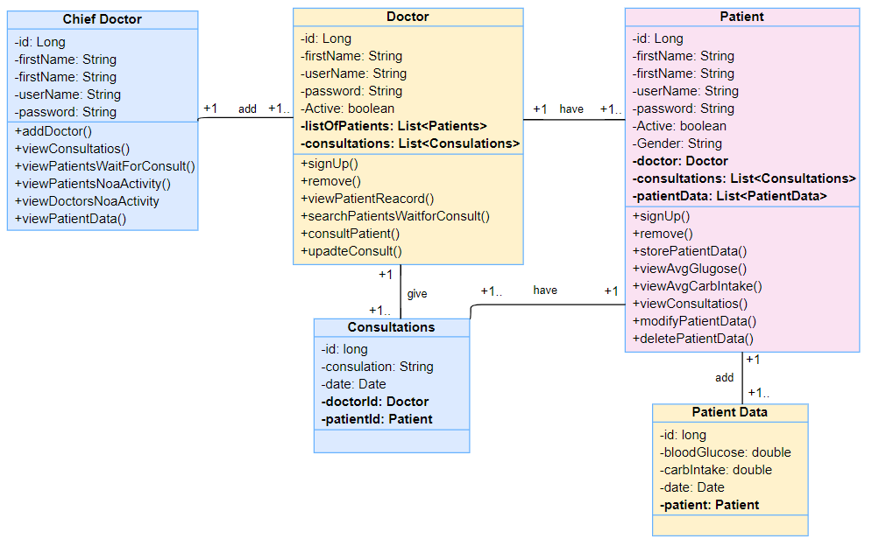
Class Diagram

Slide 4









Work Structure
Application
Exceptions
Jpa
Model
Repository
Representation
Resource
Router
Security

Slide 5
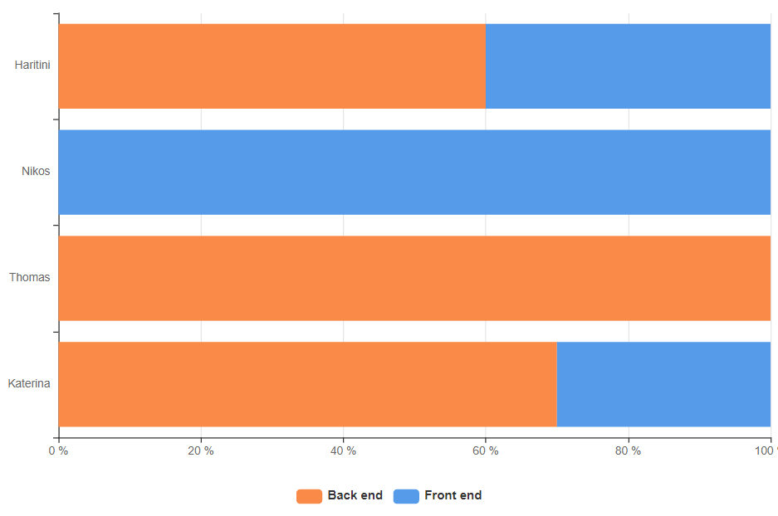



Team work

Slide 6
Live Demonstration!

Slide 7


Evaluation
All tasks completed
Great collaboration
Clean code - Javadocs
Friendly UI
Authguard
Refactoring

Slide 8
Thank you for your attention!

